Slide 1
9.3 Software Engineering Code of Ethics
9-12

Slide 2
Preamble of Code
Software engineers have opportunities to do good or do harm
Software engineers ought to be committed to doing good
Eight principles identify key ethical relationships and obligations within these relationship
Code should be seen as a whole, not a collection of parts
Concern for the public interest is paramount
9-13

Slide 3
Eight Principles Identify Morally Responsible Relationships
Public
Client and employer
Product
Judgment
Management
Profession
Colleagues
Self
9-14

Slide 4
Act Consistently with Public Interest
1.01 “Accept full responsibility for own work”
1.02 Balance competing interests
1.03 Approve software only if it is safe
1.04 Disclose actual/potential dangers
1.05 “Cooperate in efforts to address” public concerns
1.06 “Be fair and avoid deception in all statements”
1.07 Consider factors that diminish access to software
1.08 “Volunteer professional skills to good causes”
9-15

Slide 5
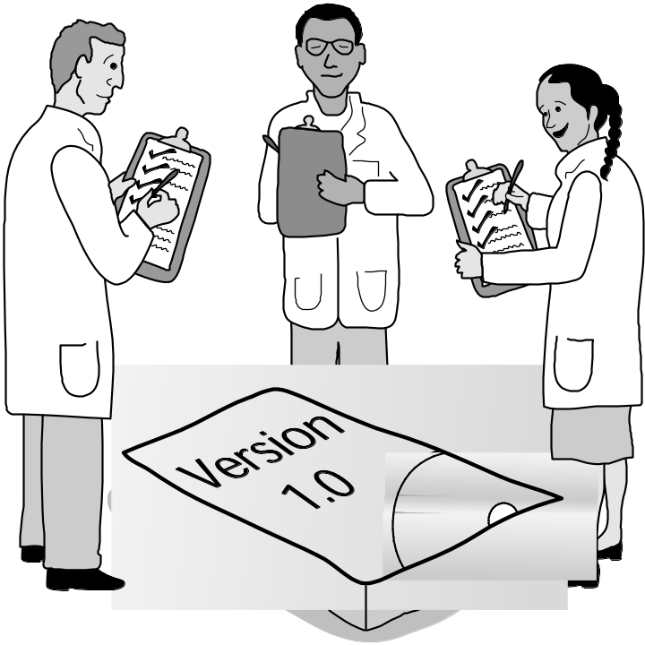
Clause 1.03
Approve Software Only If It Is Safe
9-16

Slide 6
Act in Best Interest of Client, Employer
2.01 Act within areas of competence
2.02 Don’t use software obtained illegally
2.03 Only use property in authorized ways
2.04 Ensure documents are approved
2.05 Respect confidentiality
2.06 Promptly report problems with project
2.07 Report issues of social concern
2.08 Refuse outside work detrimental to job
2.09 Put employer’s/client’s interests first, unless overriding moral concern
9-17

Slide 7
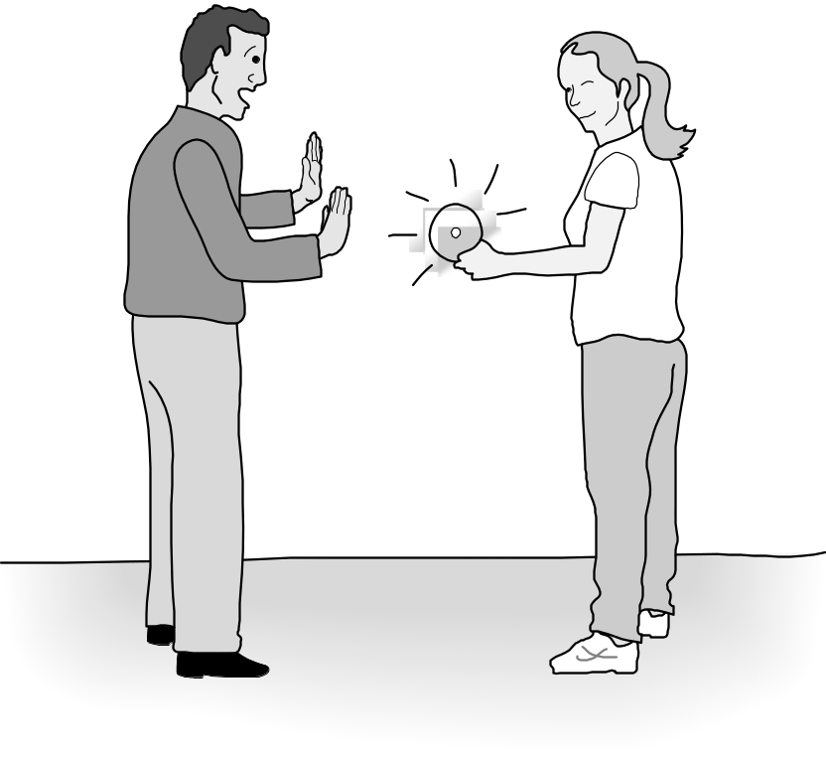
Clause 2.02
Don’t Use Software Obtained Illegally
9-18

Slide 8
Ensure Products Meet Highest Standards
3.01 Aim for “high quality, acceptable cost and a reasonable schedule,” making trade-offs clear
3.02 “Ensure proper and achievable goals”
3.03 Face up to “ethical, economic, cultural, legal and environmental” issues
3.04 Ensure you are qualified for proposed work
3.05 Use appropriate project methodologies
3.06 Follow the most appropriate professional standards
3.07 “Strive to fully understand the specifications”
3.08 Ensure the specifications are correct and approved
9-19

Slide 9
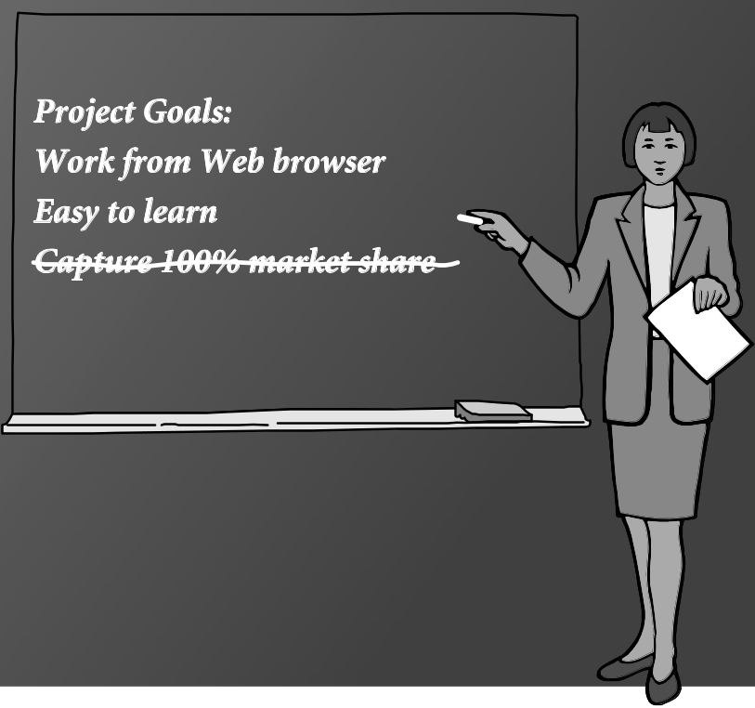
Clause 3.02
“Ensure Proper and Achievable Goals”
9-20

Slide 10
Ensure Products Meet Highest Standards
3.09 “Ensure realistic quantitative estimates of cost, scheduling, personnel, quality and outcomes”
3.10 “Ensure adequate testing, debugging, and review of software and related documents”
3.11 “Ensure adequate documentation”
3.12 Develop software and documents that respect privacy of those affected by software
3.13 Use only accurate data appropriately acquired
3.14 Maintain data integrity
3.15 Use same standards for software maintenance as software development
9-21

Slide 11
Maintain Integrity in Professional Judgment
4.01 “Temper all technical judgments by the need to support and maintain human values”
4.02 Understand and agree with documents before endorsing them
4.03 Remain objective when evaluating software or related documents
4.04 Do not engage in deceptive financial practices
4.05 Disclose conflicts of interest
4.06 Do not participate in decisions in which you, your employer, or your client has a potential conflict of interest
9-22

Slide 12
Promote Effective Project Management
5.01 Ensure good project management procedures
5.02 Ensure software engineers know standards
5.03 Ensure software engineers know policies and procedures for protecting confidential information
5.04 Take employees’ abilities into account before assigning work
5.05 Ensure reasonable estimates are made
5.06 Give full and accurate information to potential employees
9-23

Slide 13
Promote Effective Project Management
5.07 Pay employees fairly
5.08 Do not unjustly prevent a qualified person from taking a job
5.09 Work out fair intellectual property agreements
5.10 Provide employees charged with misconduct due process
5.11 Do not ask someone to do anything violating the Code
5.12 “Do not punish anyone for expressing ethical concerns about a project”
9-24

Slide 14
Advance the Profession
6.01 Help create an environment supporting ethical conduct
6.02 “Promote public knowledge of software engineering”
6.03 Participate in professional activities
6.04 Support others who are trying to follow this Code
6.05 Do not promote self-interest at expense of profession, client, or employer
6.06 Obey all laws unless there is an overriding public interest
6.07 Do not deceive others regarding the characteristics of software
9-25

Slide 15
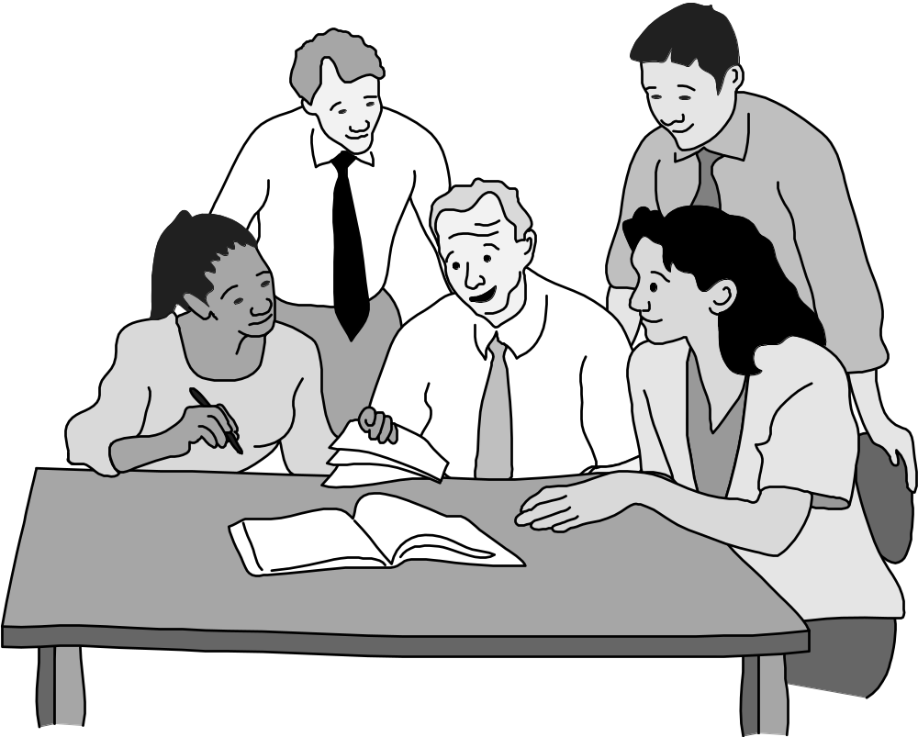
Clause 6.01 Help Create An Environment Supporting Ethical Conduct
9-26

Slide 16
Advance the Profession
6.08 Take responsibility for finding, correcting, and reporting errors in software and documentation
6.09 Ensure others know you are committed to the Code and what that means
6.10 Do not associate with businesses and organizations that are in conflict with Code
6.11 Understand violating the Code is inconsistent with being a professional
6.12 Share concerns about Code violations with the people involved
6.13 “Blow the whistle” when no alternative to reporting significant Code violations
9-27

Slide 17
Be Fair to and Supportive of Colleagues
7.01 “Encourage colleagues to adhere to this Code”
7.02 “Assist colleagues in professional development”
7.03 Give others the credit they deserve
7.04 Be objective when reviewing the work of others
7.05 Give colleagues a fair hearing
7.06 Help colleagues remain aware of work practices
7.07 Do not unfairly interfere with another’s career, but protect the public interest
7.08 Bring in experts for situations outside your own area of competence.
9-28

Slide 18
Participate in Lifelong Learning
8.01 Stay current with developments in field
8.02 Improve ability to create high quality software
8.03 Improve ability to produce high quality documentation
8.04 Improve understanding of software and documentation used in work
8.05 Improve knowledge of relevant standards
8.06 Improve knowledge of this Code and its application
8.07 Do not treat others unfairly because of prejudices
8.08 Do not influence others to break the Code
8.09 “Recognize that personal violations of this Code are inconsistent with being a professional software engineer”
9-29

Slide 19

Clause 8.02 Improve Ability to Create High Quality Software
9-30

Slide 20
ACM Code of Ethics
NJIT ©2017
Notes:
The Quinn text focuses on the Software Engineering Code of Ethics
First a brief intro, which the Quinn text doesn’t seem to have…
Then we look at a few of the ACM codes, several with comments in the slide notes.

Slide 21

ACM Code of Ethics
Adopted by ACM Council 10/16/92.
24 imperatives formulated as statements of personal responsibility
contains many, but not all, issues professionals are likely to face.
http://www.acm.org/constitution/code.html
NJIT ©2017
Notes:
You should read and memorize the 24 topic headings of the ACM Code of Ethics so you can apply them when you need to as a professional, as well as use them in our class discussions and assignments.
Also understand the corresponding joint ACM/IEEE Software Engineering Code of Ethics.

Slide 22
ACM Code of Ethics vs.
Joint ACM/IEEE Software Engineering Code of Ethics
Both codes are valid, and they do clearly overlap
The ACM/IEEE Software Engineer Code is more targeted at the job of a software engineer.
The ACM Code is more general for all computing professionals.
NJIT ©2017

Slide 23
ACM Code of Ethics
Section 1 outlines fundamental ethical considerations
Section 2 addresses additional, more specific considerations of professional conduct.
NJIT ©2017
Notes:
Overview: 4 sections

Slide 24
ACM Code of Ethics
Section 3 pertains more specifically to individuals who have a leadership role, whether in the workplace or as a volunteer, with organizations like ACM.
Principles involving compliance with this Code are given in Section 4.
NJIT ©2017

Slide 25
1.1 Contribute To
Society And Human Well-being
An essential aim of computing professionals is to
minimize negative consequences
of computing systems,
including threats to health and safety.
NJIT ©2017

Slide 26
1.1 Contribute To
Society And Human Well-being
When designing or implementing systems, computing professionals must attempt to ensure that:
  The products of their efforts will be used in socially responsible ways,
  Will meet social needs, and
  Will avoid harmful effects to health/welfare.
NJIT ©2017
Notes:
This means that designers and programmers must think ahead of time, how will people use my technology? If they might use this in unethical ways, can I design in ways to prevent that?
For example, with file sharing software can you build in digital rights management, so people can’t make copies of copyrighted music or movies. For example, if the user pays for a movie, can he/she then make a copy that someone else can use on a different computer?
Napster didn’t do this and got sued and put out of business. Other more recent cases.

Slide 27
1.2 Avoid Harm To Others
Harm means injury or negative consequences, such as undesirable loss of information, loss or property, property damage, or
unwanted environmental impacts.
NJIT ©2017
Notes:
Harm: Does your word processer/spreadsheet do autosave? What about web forms? Have you been “harmed” when you have lost data you were typing?
Is backing up easy? (Easy to duplicate on Mac, hard on Windows; Mac’s Time Machine and Window’s back up center make backing up easy. This is a recent development.)
Are logins and passwords encrypted and not emailed around, protecting people’s property? Does your email block spam well, so people aren’t taken advantage of by spammers?
Undesirable loss of information: also people’s private data

Slide 28
1.3 Be Honest And Trustworthy
Honesty is an essential component of trust. Without trust an organization cannot function effectively. The honest computing professional will not make deliberately false or deceptive claims about a systems or system design, but will instead provide full disclosure of all pertinent system limitations and problems.
NJIT ©2017
Notes:
How much do you trust politician’s claims?
When several consultants bid on a software development project, which will you hire? How much do you trust each when they tell you how much time it will take to develop software and the cost? (New York City’s CityTime payroll project…)
What about programmers inside your organization who are being overly optimistic? (overly optimistic vs. deliberately false – experienced professionals should know better???)

Slide 29
1.3 Be Honest And Trustworthy
A computer professional has a duty to be honest about his or her own qualifications, and about any circumstances that might lead to conflicts of interest.
NJIT ©2017
Notes:
Qualifications: When you go for an interview and your potential employer asks you how well you know Java or PHP. What if they hire you and your skills aren’t so good and a project fails? (Has happened several times when students want to be RAs.) Is your CV accurate? I know one company that didn’t hire a professional because his CV had some exaggerations on it.
Conflict of interest: If I’m hired as a consultant, can I use NJIT (or company) resources? Can I ask a student or co-worker to do some of the work?

Slide 30
1.4 Be Fair And Take Action Not To Discriminate
The values of equality, tolerance, respect for others, and the principles of equal justice govern this imperative. Discrimination on the basis of race, sex, religion, age, disability, national origin, or other such factors is an explicit violation of ACM policy and will not be tolerated.
NJIT ©2017
Notes:
Does your web design provide universal access? Is it optimized for people who are color blind?
I just got a request for some students to work for an organization that wants to build a web site promoting gay rights. If I’m opposed to this, can I block their request, but support requests from other types of non-profit organizations?
If short on time, perhaps stop here and do CONFIRM exercise.

Slide 31
1.5 Honor Property Rights Including Copyrights / Patents
Violation of copyrights, patents, trade secrets and the terms of license agreements is prohibited by law in most circumstances.
Even when software is not so protected, such violations are contrary to professional behavior. Copies of software should be made only with proper authorization. Unauthorized duplication of materials must not be condoned.
NJIT ©2017
Notes:
In your professional life as well as in your personal life.
As a computing professional, have you violated copyright?

Slide 32
1.7 Respect The Privacy Of Others
It is the responsibility of professionals to maintain the privacy and integrity of data describing individuals.
This includes taking precautions to ensure the accuracy of data, as well as protecting it from unauthorized access or accidental disclosure to inappropriate individuals. Furthermore, procedures must be established to allow individuals to review their records and correct inaccuracies.
NJIT ©2017

Slide 33
1.7 Respect The Privacy Of Others
This imperative implies that only the necessary amount of personal information be collected in a system, that retention and disposal periods for that information be clearly defined and enforced, and that personal information gathered for a specific purpose not be used for other purposes without consent of the individual(s).
NJIT ©2017

Slide 34
1.8 Honor Confidentiality
With respect to clients, employers, users, co-workers, other professionals.
NJIT ©2017
Notes:
Can IRS workers look at their neighbor’s tax returns?
Can an advisor look at their college son’s grades (having a different major)?
Can someone in HR share a co-worker’s salary?
(What about the disclosure that led to the Lilly Ledbetter Fair Pay Act?)

Slide 35
2. More Specific Professional Responsibilities
2.3 know and respect existing laws pertaining to professional work
2.4 accept and provide appropriate professional review
NJIT ©2017
Notes:
Seek legal advice from your company lawyer if you suspect something you might design or might do is illegal.
Professional Review (e.g., walk-throughs): Allow co-workers + clients to see your designs/code, and accept criticism

Slide 36
2.5 Give Comprehensive And Thorough Evaluations...
Of computer systems and their impacts, including analysis of possible risks
Computer professionals must strive to be perceptive, thorough, and objective when evaluating, recommending, and presenting system descriptions and alternatives.
NJIT ©2017
Notes:
Especially when you are communicating with non-professionals. If they don’t understand or are intimidated by technology, it’s your job to make the options clear and unbiased.
What if your boss asks your opinion of 2 different products? What about a client? What about a politician? What about your friend (asking about [insert 2 tech products here] Microsoft Windows-compatible vs Apple SmartPhones; Microsoft HoloLens vs. Oculus Rift)?
What if you have a conflict of interest or just a bias?

Slide 37
2.5 Give Comprehensive And Thorough Evaluations...
Computer professionals are in a position of special trust, and therefore have a special responsibility to provide objective, credible evaluations to employers, clients, users, and the public.
NJIT ©2017

Slide 38
3. Organizational Leadership
3.1 Articulate organization’s responsibility to society…
3.5 … to dignity of users…
3.2/3.4 design systems that meet users’ needs, and enhance the quality of working life; validate that the system developed meets requirements
NJIT ©2017

Slide 39
4. Compliance With The Code
4.1 promote the principles... Each member should adhere to the code and encourage and support adherence by others
4.2 violations of the code are inconsistent with membership in the ACM. If a member does not follow the code, membership may be terminated
NJIT ©2017
Notes:
Compliance with the Code of Ethics.
BTW, you should become an ACM and/or IEEE Student member!!!

Slide 40
Referring to Codes of Ethics
Written rules of one’s profession
Clear guidelines for behavior
Authority/Legitimacy based upon:
  Broad, participatory development by members of the field, especially ‘elders’
  Longevity—standing the ‘test of time’
  Clear statement of concern for the well-being of society—i.e., difficult to contradict
Downsides:
  Not generally legally binding
  Do not provide airtight legal protection
NJIT ©2017
Notes:
Mostly a summary, but note the last bullet – in the computing profession, the codes are not legally binding.

